Slide 1
Developer Training
WCO

Slide 2
AGENDA
What is WCO? What can we do with it?
HANDS-ON: Update our Simple Page to enable WCO
HANDS-ON: Make a simple A/B test and report on the winner
HANDS-ON: Using targeting to provide customized content
HANDS-ON: Using a form to gate access to content

Slide 3
What is WCO?
What can we do with it?

Slide 4
What is WCO?
Web Content Optimizer – Provided as a runtime service
Crownpeak’s platform for Testing, Targeting and Personalization
A/B Testing
Persona-based Targeting
User Forms and Personalization
Helping you deliver dynamic content to your customers
Manage content within the CMS
Deploy multiple variants when you publish
Render dynamic content at runtime

Slide 5
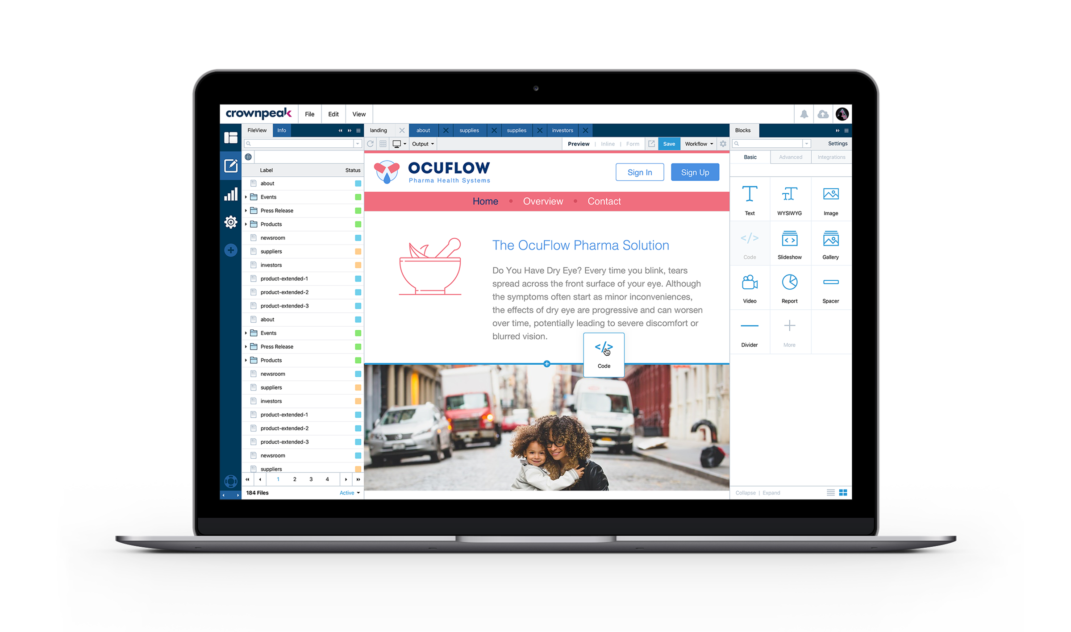
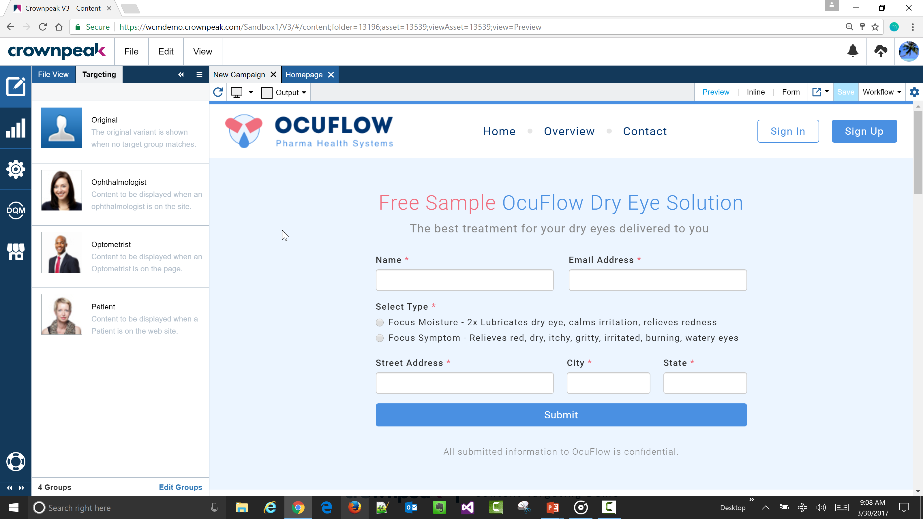
Content Targeting
Easy to create personalized experiences
Marketing messages for specific visitor personas

Slide 6





Content Targeting
Persona A
Anonymous Visitor
Business Logic
Persona B
Persona C

Slide 7
Content Targeting Rules
Browser Session
Browser Cookie
Integrations
“ambient data”
date
time
browser / device
referrer
geo-IP lookup
keyword?
page (snippet) visited
snippet conversion
submitted form fields
Marketo
Demand Base
Hubspot
custom integration

Slide 8
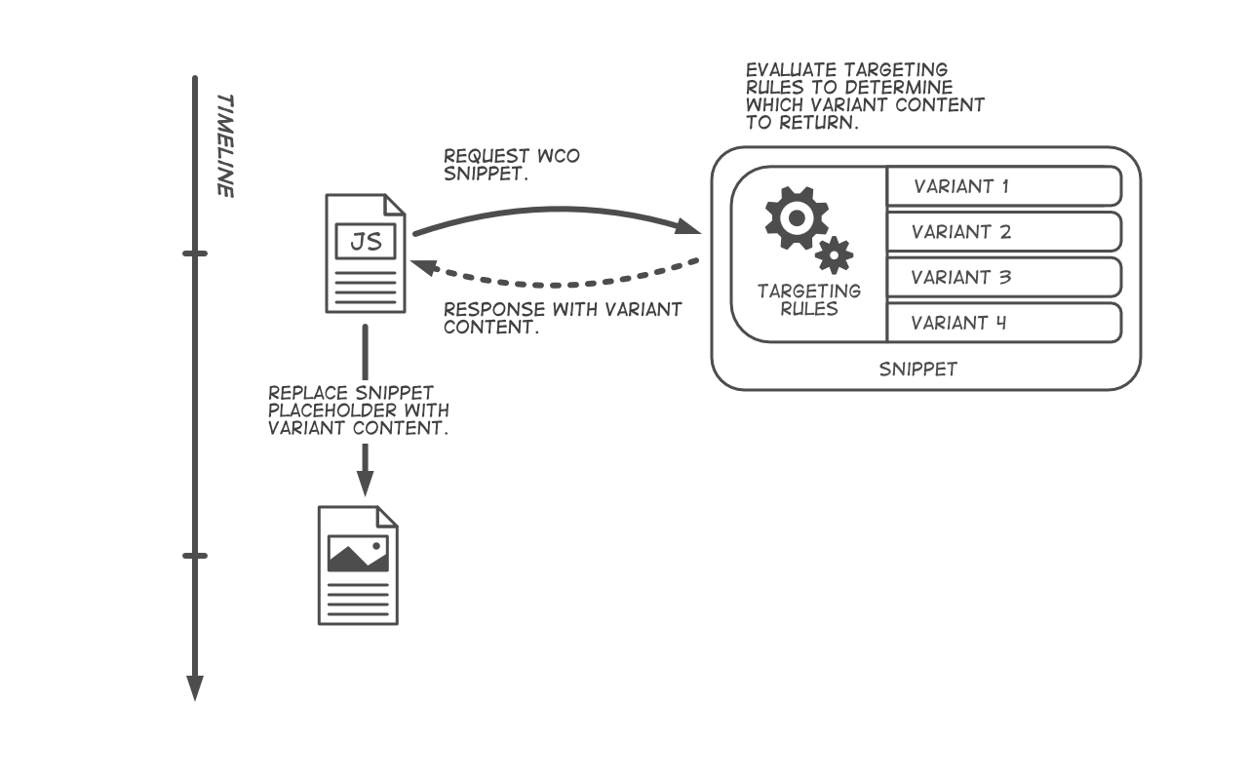
WCO request-response cycle

Slide 9
Content Testing
Easy to create A/B or multivariate tests
Marketing messages for specific visitor personas

Slide 10
Hands On
Updating a template to enable WCO controls

Slide 11
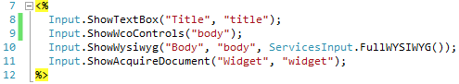
Hands-On: Enabling WCO Controls
In Visual Studio, navigate to your Templates folder
Open the Simple Page folder
Double-click on input.aspx
Before the Input.ShowWysiwyg
Input.ShowWcoControls("body");
You can use it on multiple controls in a single asset
This works on Text and WYSIWYG fields only.

Slide 12
Hands On
Making an A/B test

Slide 13
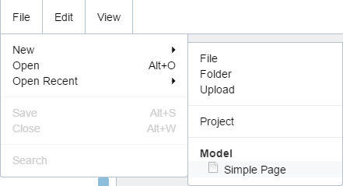
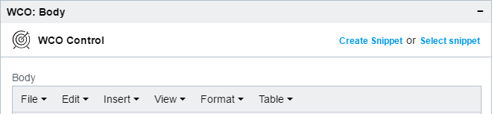
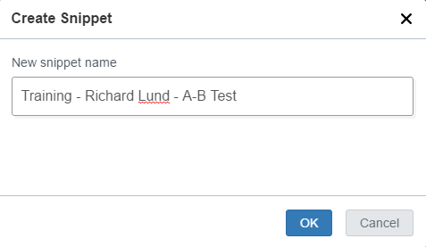
Hands-On: Making an A/B Test
In V3, navigate to your folder
Choose File > New > Simple Page
Name it A-B Test
Go to Form view
WCO has added controls
Click on Create Snippet
“Training - Your Name - A-B Test”
Click OK

Slide 14
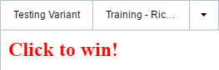
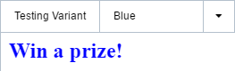
Hands-On: Making an A/B Test
Click into the WYSIWYG area
Type “Click to win!”
Change the colour to red
Use the format menu to select H2
Click Add Testing Variant
Name it “Blue”
Make sure Blue is displayed at the top
Next to “Testing Variant”
Type “Win a prize!”
Change the colour to blue
Make it H2

Slide 15
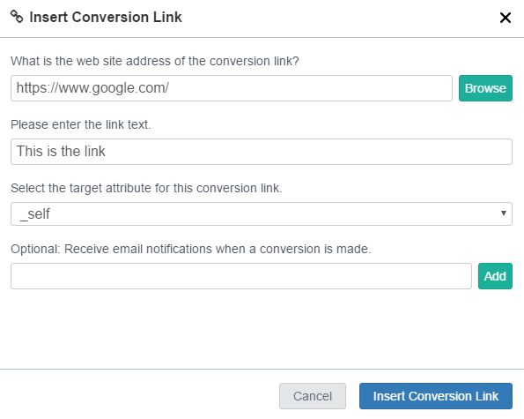
Hands-On: Making an A/B Test
Save your form
If you get validation errors, correct your input accordingly
Next we need to add conversion links
Make sure you see the red variant
Put the cursor at the end of the text
Click on and enter the details
https://www.google.com/
Link text: This is the link
Target: _Self

Slide 16
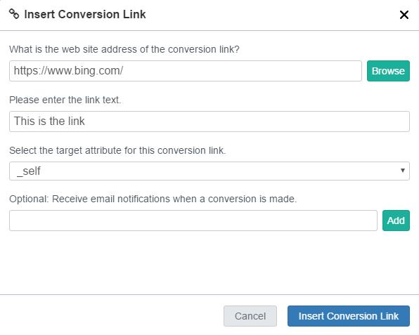
Hands-On: Making an A/B Test
Switch to the Blue variant
Put the cursor at the end of the text
Click on and enter the details
https://www.bing.com/
Link text: This is the link
Target: _Self

Slide 17
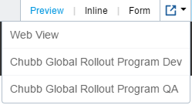
Hands-On: Making an A/B Test
Conversion links work by routing the click through a WCO handler
We can track which get clicked
And of course, report on it
WCO only works on published pages
So we can’t easily preview
Preview will show only the default variant
Standard WCO settings only publish when you send content to Live
Publish your page to Live now
This is ok because our site doesn’t publish any files past Stage
Then go to the Web View menu
Choose Dev

Slide 18


Hands-On: Making an A/B Test

Slide 19
Hands-On: Making an A/B Test
View the source of the page
Look for the <h1> tag
Under it, you can see a script
snippet.omm.crownpeak.com
Each one has a unique GUID
The server sends down each variant
Randomly according to weighting
Considerations:
WCO part of the page will load later
Try to avoid layout shifting
Can do multiple snippets on page
They won’t switch together
If you’re publishing to Search G2 then you have work to do
asset["body"] will be the script tag
asset["ommvariantid#body"] has a guid
asset["ommvarcont#guid"] has the content

Slide 20
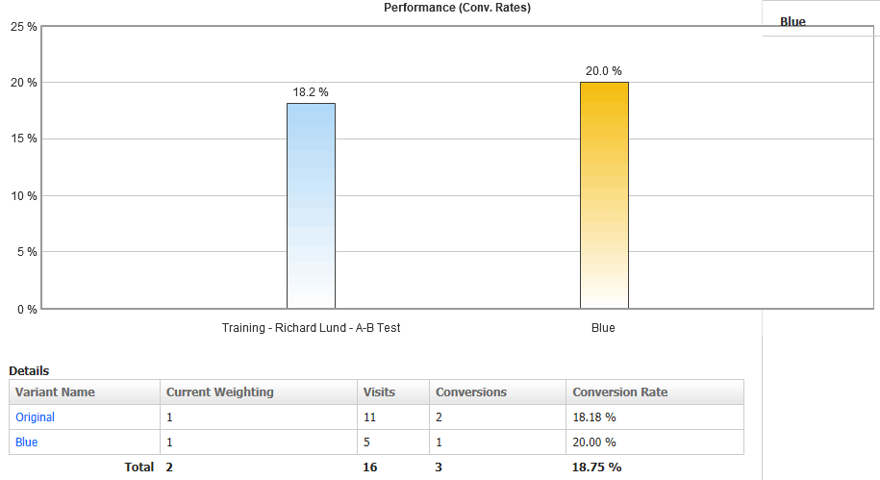
Hands-On: Making an A/B Test
In Volte, click on Apps on the left rail
Click WCO on the flyout
Click Reports at the top-left
Click on your snippet
First you see an overview dashboard
Click on Testing at the top
Live data is shown here
V3 has this too, but delayed 24 hours
Visits vs conversions for all variants

Slide 21
Hands On
Using targeting to deliver custom content

Slide 22
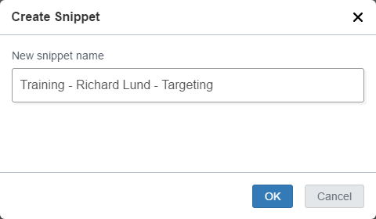
Hands-On: Using targeting
In V3, navigate to your folder
Choose File > New > Simple Page
Name it Targeting
Go to Form view
You will see the WCO controls
Click on Create Snippet
“Training - Your Name - Targeting”
Click OK

Slide 23
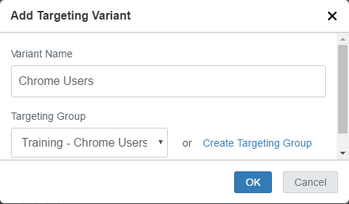
Hands-On: Using targeting
Click into the WYSIWYG area
Enter “This is the default view.”
Click on Add Targeting Variant
Name it “Chrome Users”
Choose “Training - Chrome Users” for the Targeting Group
Click OK
Click into the WYSIWYG area
Enter “This is the Chrome view”

Slide 24
Hands-On: Using targeting
Repeat the last steps two more times
Create variants named:
Firefox Users
IE Users
Use targeting groups
Training - Firefox Users
Training - IE Users
Enter content into each WYSIWYG
Save your form
If you get validation errors, correct your input accordingly

Slide 25
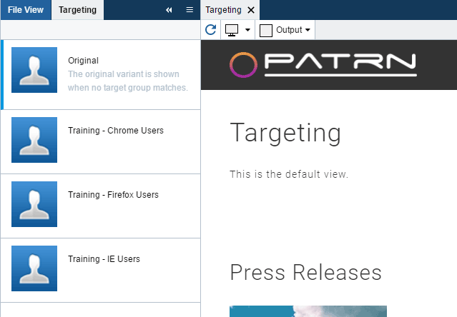
Hands-On: Using targeting
Go to the Preview
Choose View > WCO Targeting
Verify that each view looks ok
This is a good way to test before you publish your page
Publish the page to Live
Go to Web View and choose Dev
Try the link in different browsers

Slide 26
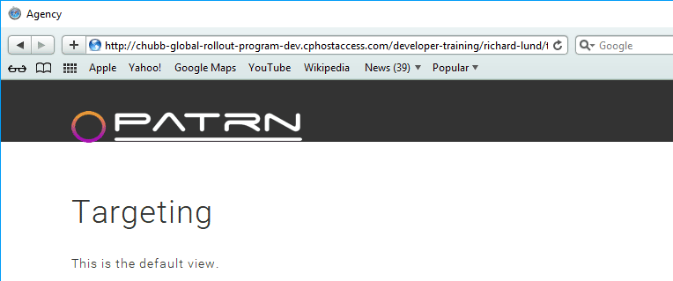
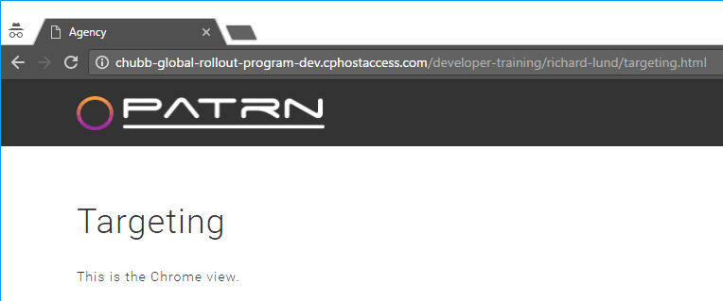
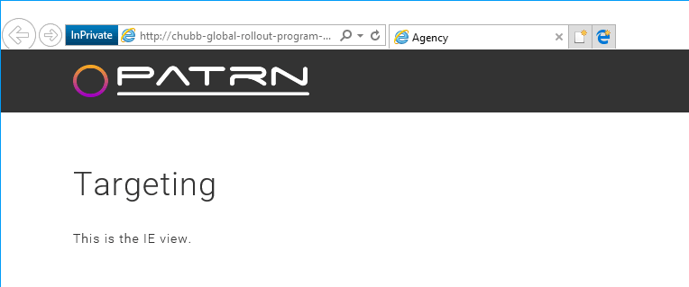
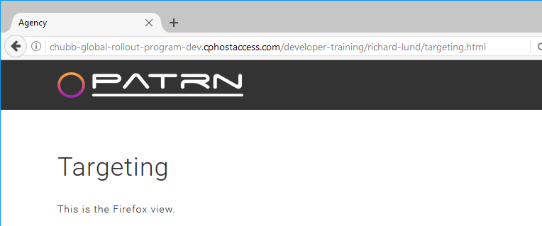
Hands-On: Using targeting

Slide 27
Hands-On: Using targeting
Lots of other targeting options
Ambient data:
Date/time
Referrer
Keywords (from search)
Browser (mobile vs desktop)
Geospatial
Country / state / zip
Or draw a shape!
Form data
User completes a survey form
Or even just logs in
You can post back from anything
Quiz / survey / favourites

Slide 28
Hands-On: Using targeting
Even more targeting options
Behavioural data:
User has visited other snippet
Or other variant
User has converted variant
(up to n times)
Or just clicked on a link
Integrations
Demandbase
Marketo
Hubspot
Or any combination of all of these!

Slide 29
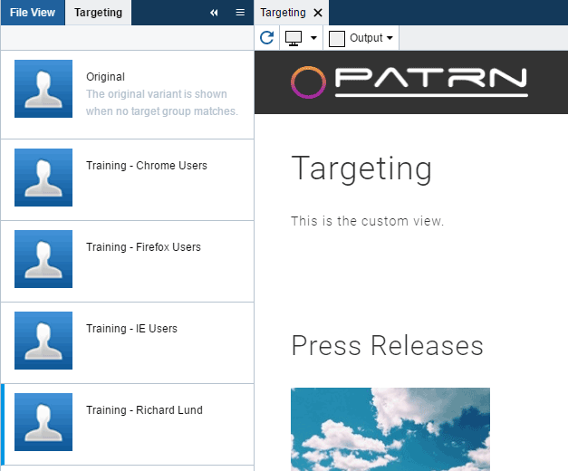
Hands-On: Using targeting
Go to the Form view of your page
Click Add Targeting Variant
Name it “Custom”
Click “Create Targeting Group”
Click New Group
Name it “Training – your name”
Enter whatever rules you wish
Click Save, then click X to close
Choose your rule in the dropdown
Click OK

Slide 30
Hands-On: Using targeting
Type some different content into the WYSIWYG
Save your page
Go to Preview
Use the WCO Targeting panel to verify your variant displays
Publish your page
Test out your custom view
Does it draw when you expect?
Try out changing and republishing
This happens very quickly
Easy to change the rules later
Good for dynamic content

Slide 31
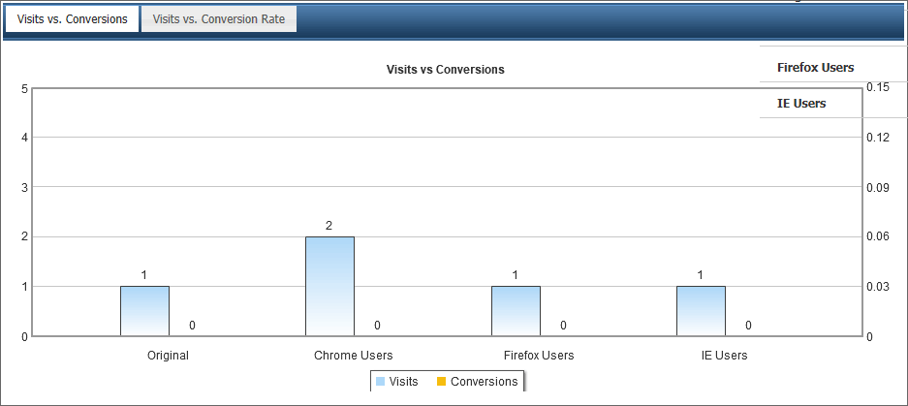
Hands-On: Using targeting
As before we have reporting
In Volte go to Apps > WCO
Click Reports
Find your snippet and click on it
Click on Targeting tab
No conversions this time
We didn’t add any links

Slide 32
Hands On
Using a form to gate access to content

Slide 33
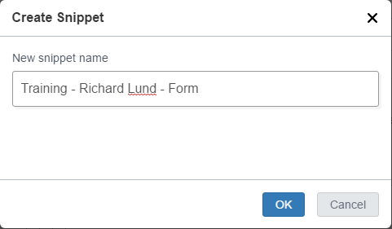
Hands-On: Using a form
In V3, navigate to your folder
Choose File > New > Simple Page
Name it “Form”
Go to Form view
You see the usual WCO controls
Click on Create Snippet
“Training - Your Name - Form”
Click OK

Slide 34
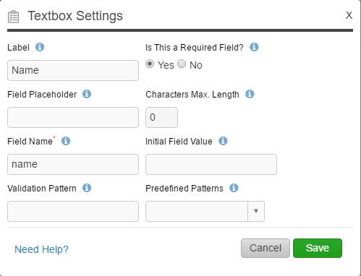
Hands-On: Using a form
Click on to build a Form
Click on New Form
Click on the Existing tab
Drag Name onto the form
Click Edit to see how it’s defined
Click Cancel to close the popup

Slide 35
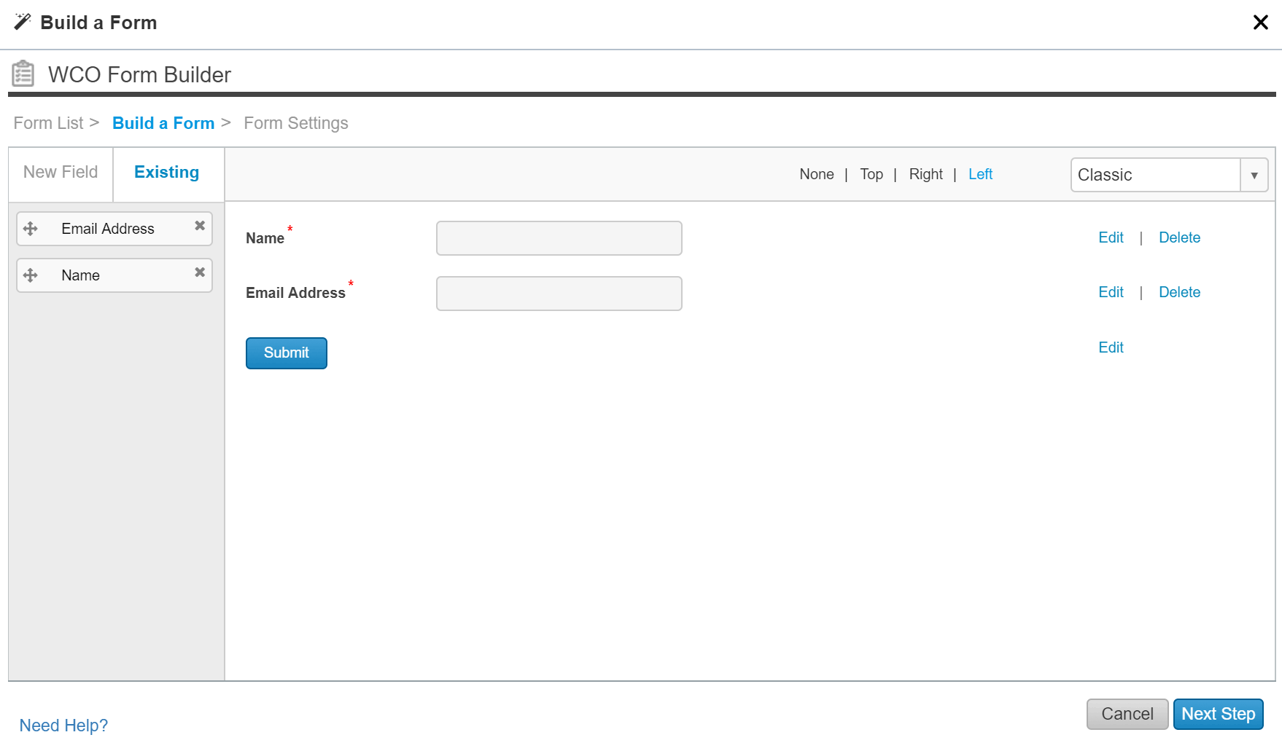
Hands-On: Using a form
Drag the Email Address field on
Beneath Name
Drag to reorder if necessary
Click Edit to look at the properties
If you make changes, you could affect all uses of this field
Click the Next Step button

Slide 36
Hands-On: Using a form
Name your form
Training - your name
Look through each tab
Notifications
Can send an email on submission
XML or Text format
Rules - Redirect to
http://sandpglobal-training-dev.cphostaccess.com/developer-training/[your-name]/form.html
Or you could make a Thank You page
Connectors are here too
Auto-reply
Click Save and Insert Form

Slide 37
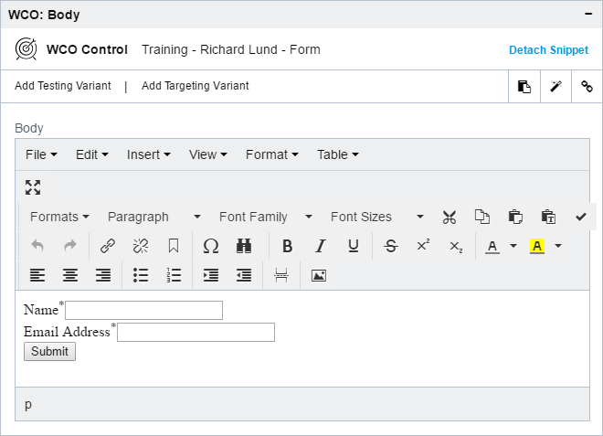
Hands-On: Using a form
The form is added to your WYSIWYG
Click Add Targeting Variant
Name it “Secret Content”
Choose “Training - Form completed”
Replace the content with a message
As before you need to Save
Sometimes a strange error here
Try again if so
Publish once it succeeds

Slide 38
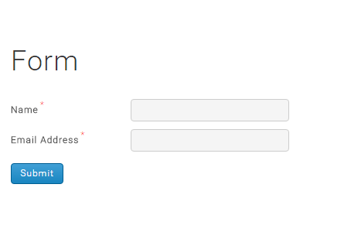
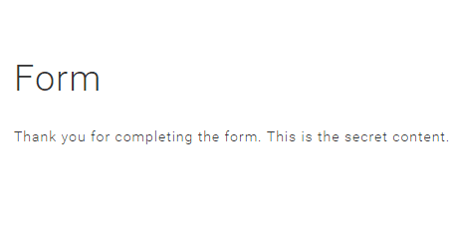
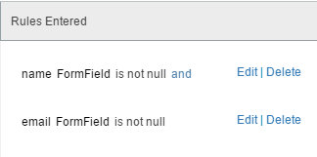
Hands-On: Using a form
Can you guess how the targeting worked?

Slide 39
Hands-On: Using a form
You’re not limited to what WCO puts on your form
You can modify or replace the HTML and the JavaScript that it creates
Very common to do this – to better fit your site’s look and feel
You can even add more fields
Every field will be stored, though only those set up in WCO will show up
In rules…
… and in reports

Slide 40
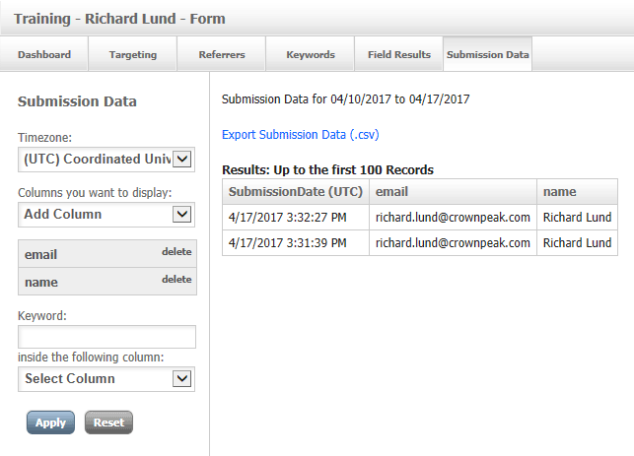
Hands-On: Using a form
As before we have reporting
In Volte go to Apps > WCO
Click Reports
Find your snippet and click on it
Click on Submission Data tab
Select Add All and click Apply

Slide 41
Thank You!

